Slide 1
TensorFlow
the basics.
-BY
Dhiraj Mangaldas Wadile
23361
SE-11(G-11)

Slide 2
01
02
HISTORY
APPLICATIONS
A little bit of background on TensorFlow
Where and how TensorFlow is used

Slide 3
“A breakthrough in machine learning would be worth ten Microsofts”
— Bill Gates

Slide 4
History
01
A bit of background on TensorFlow

Slide 5
Distbelief
Starting in 2011, Google Brain built DistBelief as a proprietary machine learning system based on deep learning neural networks. Its use grew rapidly across diverse Alphabet companies in both research and commercial applications.
Google assigned multiple computer scientists, including Jeff Dean, to simplify and refactor the codebase of DistBelief into a faster, more robust application-grade library, which became TensorFlow.

Slide 6
TensorFlow
TensorFlow is Google Brain's second-generation system. Version 1.0.0 was released on February 11, 2017. While the reference implementation runs on single devices, TensorFlow can run on multiple CPUs and GPUs (with optional CUDA and SYCL extensions for general-purpose computing on graphics processing units).
TensorFlow is available on 64-bit Linux, macOS, Windows, and mobile computing platforms including Android and iOS.

Slide 7
TensorFlow
Its flexible architecture allows for the easy deployment of computation across a variety of platforms (CPUs, GPUs, TPUs), and from desktops to clusters of servers to mobile and edge devices.
TensorFlow computations are expressed as stateful dataflow graphs. The name TensorFlow derives from the operations that such neural networks perform on multidimensional data arrays, which are referred to as tensors.

Slide 8
TensorFlow
In March 2018, Google announced TensorFlow.js version 1.0 for machine learning in JavaScript.
In Jan 2019, Google announced TensorFlow 2.0. It became officially available in Sep 2019.
In May 2019, Google announced TensorFlow Graphics for deep learning in computer graphics.

Slide 9
Tensor Processing Units
In May 2016, Google announced its Tensor processing unit (TPU), an application-specific integrated circuit (ASIC, a hardware chip) built specifically for machine learning and tailored for TensorFlow.
A TPU is a programmable AI accelerator designed to provide high throughput of low-precision arithmetic (e.g., 8-bit), and oriented toward using or running models rather than training them. Google announced they had been running TPUs inside their data centers for more than a year, and had found them to deliver an order of magnitude better-optimized performance per watt for machine learning.

Slide 10
TensorFlow 2.0
As TensorFlow's market share among research papers was declining to the advantage of PyTorch, the TensorFlow Team announced a release of a new major version of the library in September 2019.
TensorFlow 2.0 introduced many changes, the most significant being TensorFlow eager, which changed the automatic differentiation scheme from the static computational graph, to the "Define-by-Run" scheme originally made popular by Chainer and later PyTorch.
Other major changes included removal of old libraries, cross-compatibility between trained models on different versions of TensorFlow, and significant improvements to the performance on GPU.

Slide 11
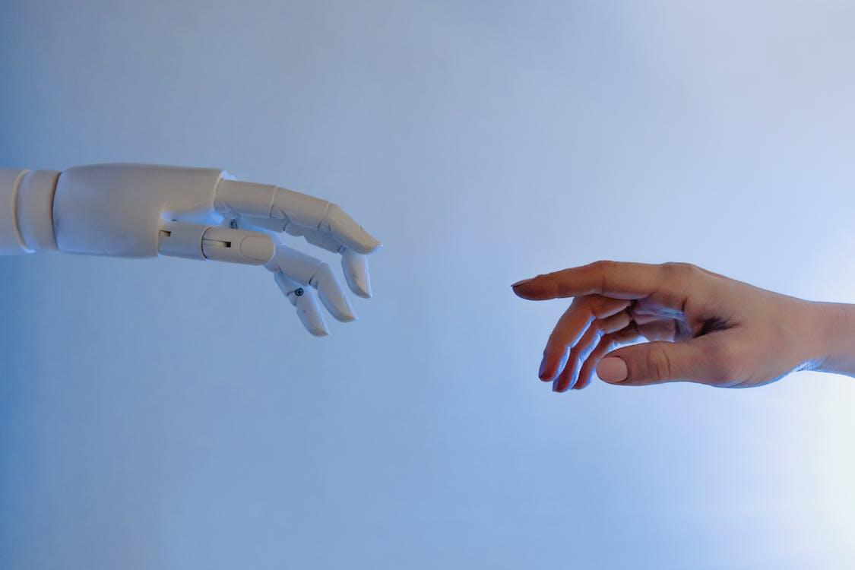
Applications of TensorFlow

Slide 12

RANKBRAIN
Developed by Google, it is a large-scale deployment of deep neural nets for search ranking on www.google.com. It is a part of the search algorithm that’s used to sort through the billions of pages it knows about and find the ones deemed most relevant. It is also the most talked about Tensorflow Applications.

Slide 13

INCEPTION IMAGE CLASSIFIER
Inception Image Classifier, developed by Google, is a baseline model and follow-on research into highly accurate computer vision models, starting with the model that won the 2014 Imagenet image classification challenge and started the era of convolutional networks.

Slide 14

MODULARITY
TensorFlow offers additional conveniences for developers who need to debug and gain introspection into TensorFlow apps. Each graph operation can be evaluated and modified separately and transparently, instead of constructing the entire graph as a single opaque object and evaluating it all at once. This so-called "eager execution mode," provided as an option in older versions of TensorFlow, is now standard.

Slide 15

EASY SHARING
The TensorBoard visualization suite lets you inspect and profile the way graphs run by way of an interactive, web-based dashboard. A service, Tensorboard.dev (hosted by Google), lets you host and share machine learning experiments written in TensorFlow. It's free to use with storage for up to 100M scalars, 1GB of tensor data, and 1GB of binary object data.

Slide 16
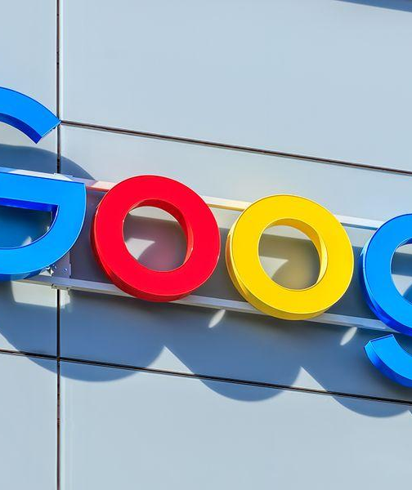
BACKED BY GOOGLE
TensorFlow also gains many advantages from the backing of an A-list commercial outfit in Google. Google has fueled the rapid pace of development behind the project and created many significant offerings that make TensorFlow easier to deploy and use.

Slide 17
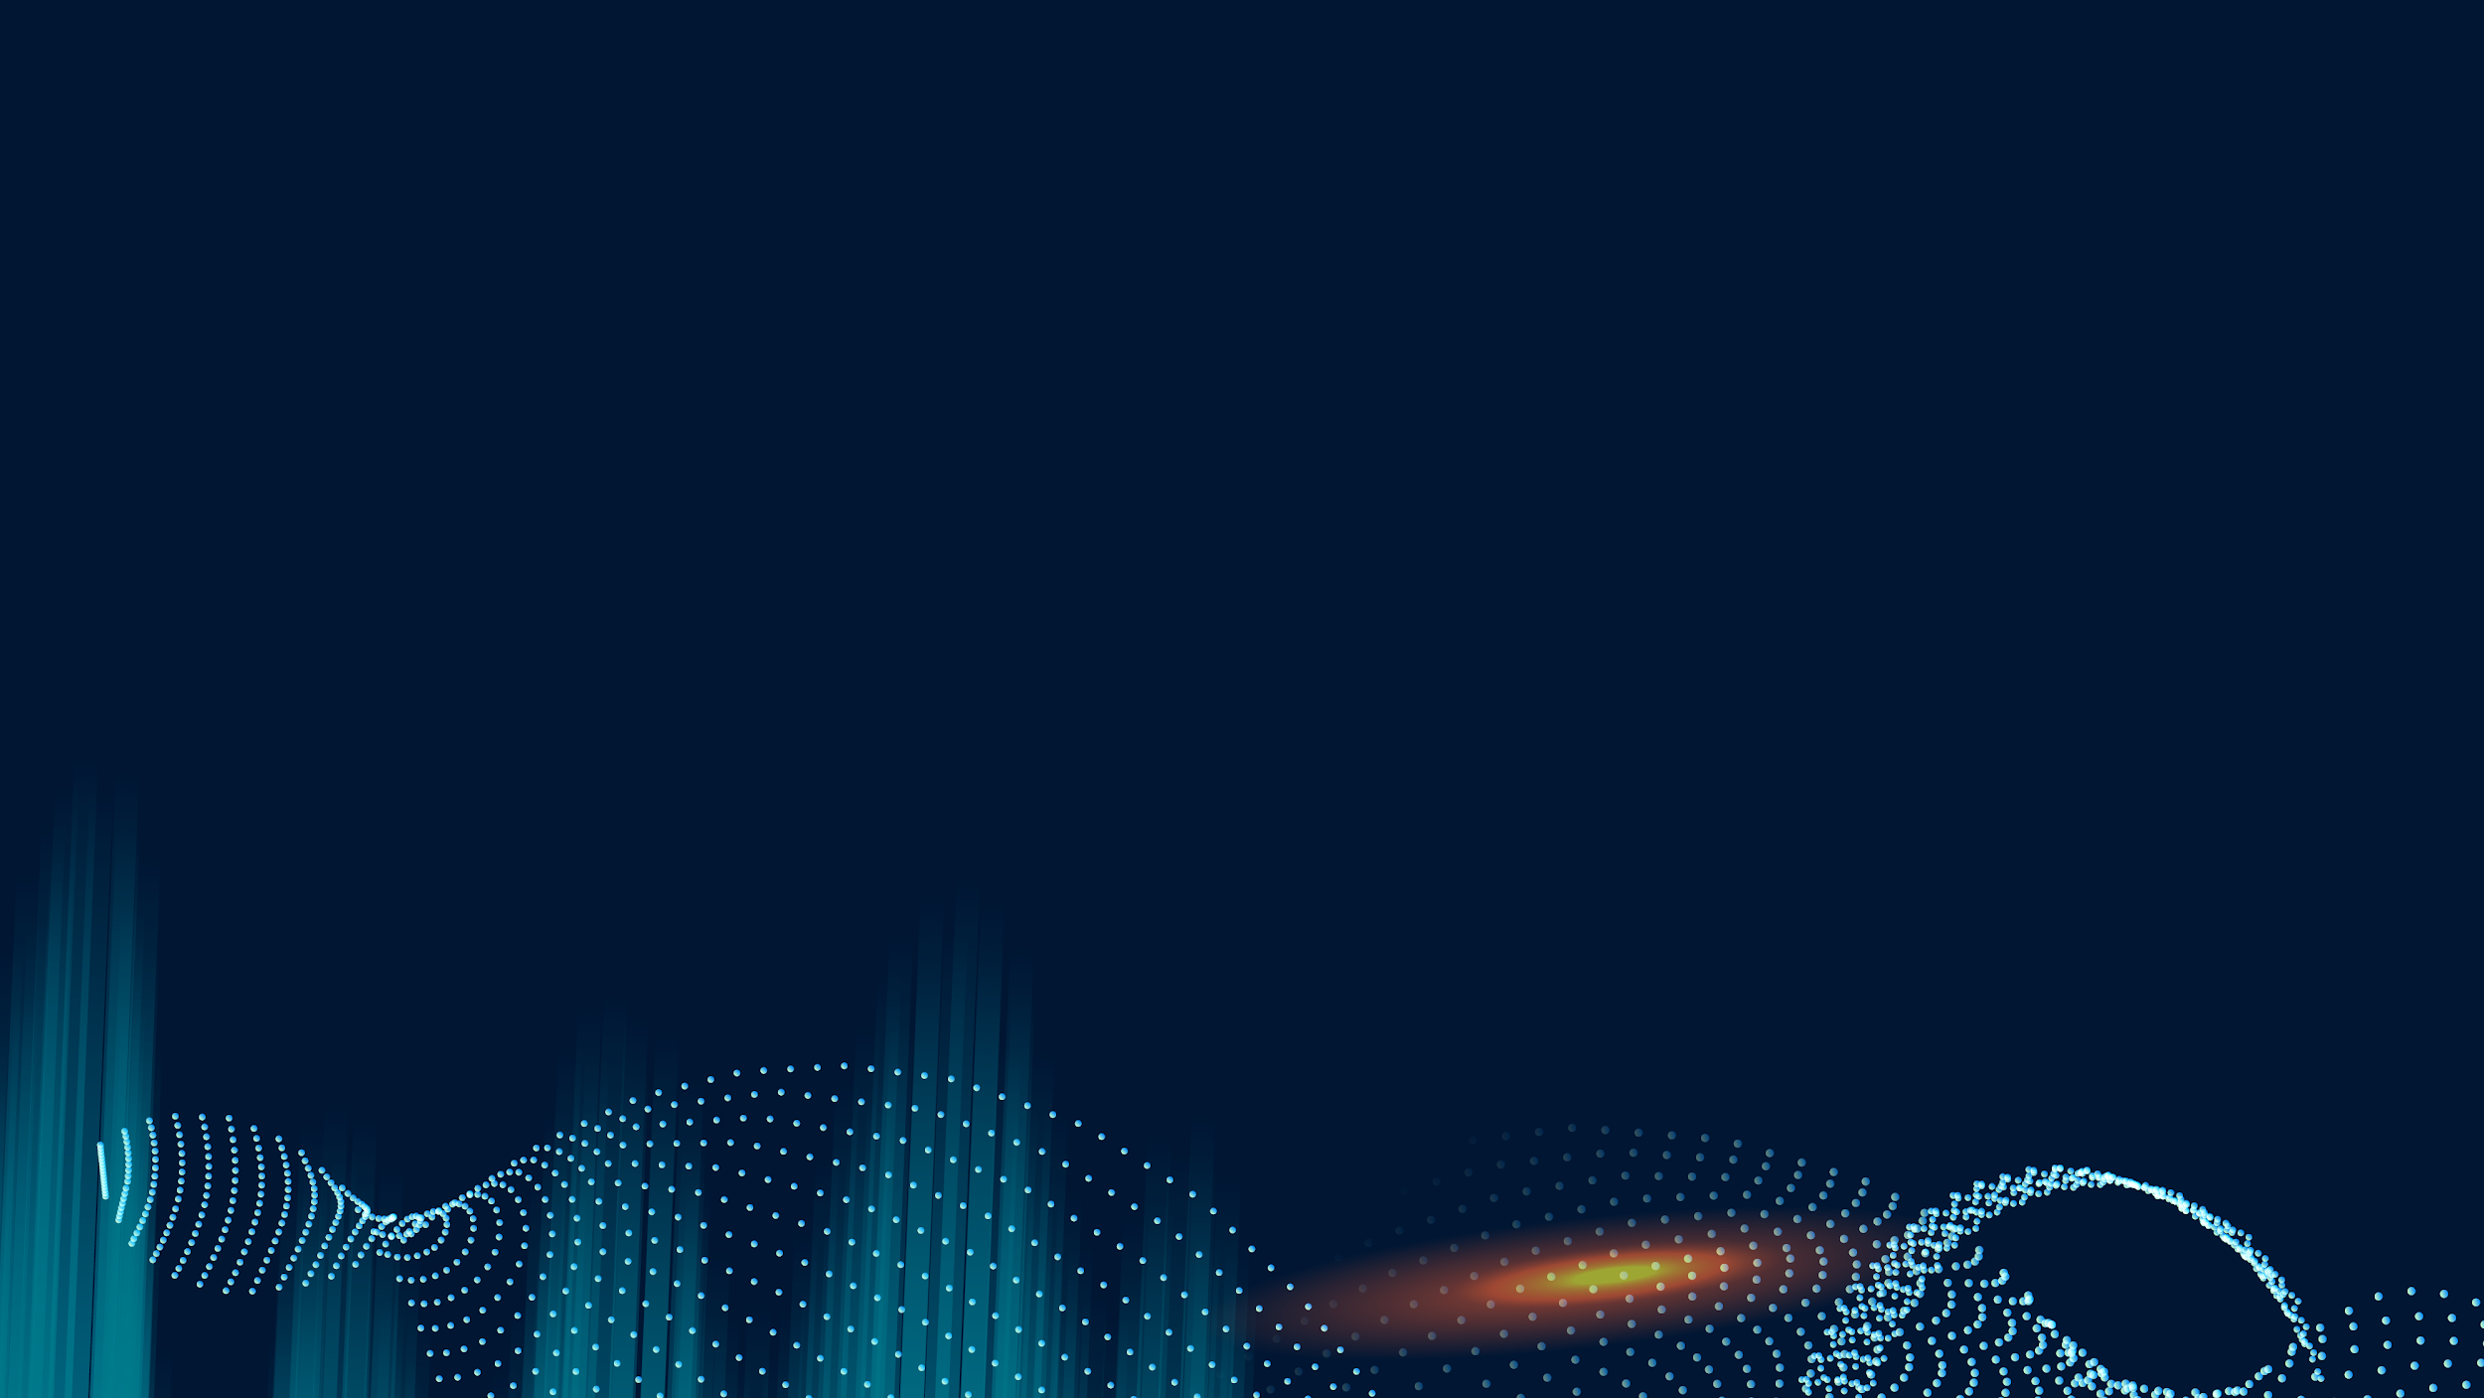
MUCHAS GRACIAS
Thank you for your patient listening!

